Slide 1
GROUP 06 Comparative analysis of the teams from the two Major football leagues: EPL and La Liga
SHANTANU JADON BE COMP A 62
Aman jain BE COMP A 63
mihir jain BE COMP A 65
MENTOR: Mr. Loukik salvi

Slide 2
Introduction
Football has traditionally been the most popular and extensively viewed sport in many European and South American countries.
Data analytics has aided the game in numerous ways. Numerous previous studies have confirmed that it is a performance indicator that allows high-level teams to be distinguished.

Slide 3
Problem Statement
Data Analytics has transformed how people approach games, team formation, player selection etc. Data analytics has enabled teams from around the world to understand their game better and perform better.
Data analytics is also used to predict the outcomes of games enabling people to make educated guesses while betting.
The aim of this study was to compare playing style and competitiveness of the two major European leagues: Spanish La Liga and English Premier League (EPL) for the 2021-2022 season.

Slide 4
Dataset
This dataset is from taken from fbref. Currently the dataset consists of multiple files having various categories.
The data consists of official records of all teams and players for the 2021-22 season.

Slide 5
Dataset
The description of individual files:
Age.csv (the age of players)
EPL_Player.csv (description of each player)
Goalkeeping data (goalkeeping stats of clubs)
Points table (performance of the club round the season)
Squad defensive (detailed defensive stats of clubs)
Squad Goal and Shot Creation (detailed attacking stats of clubs)
Squad Miscellaneous

Slide 6
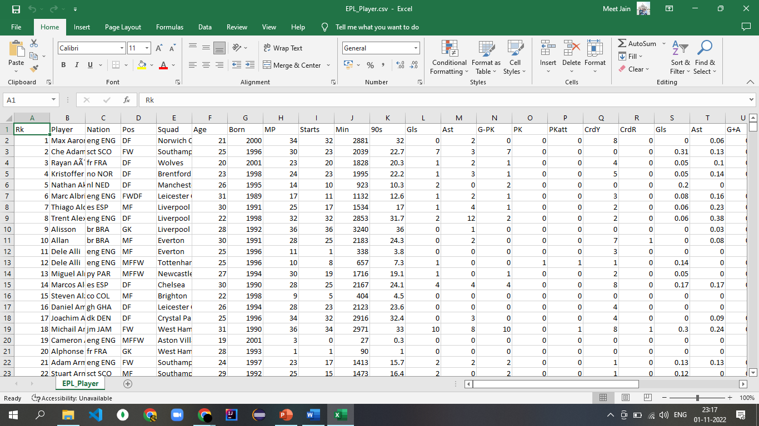
Dataset: FBREF 2021-22 EPL

Slide 7
Questions Answered
Average age of the Premier League and La Liga Squads?
Area wise ball touches of each club?
Passes completed of each type by each club?
Passes completed by each club?
Which position players scored max goals per club ?

Slide 8

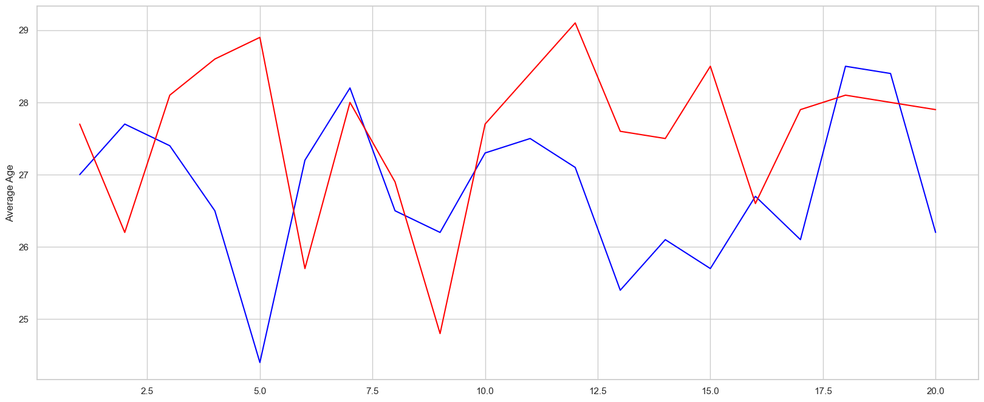
Average age of the Premier League and La Liga Squads?
The average age of players from both the leagues was analyzed.
The red line is for La Liga and blue line is for EPL.
La Liga has an higher overall average age of players than compared to EPL.
One conclusion could be drawn that players at a younger age wish to peak their careers at EPL considering it to be a more competitive or cash rich league.

Slide 9
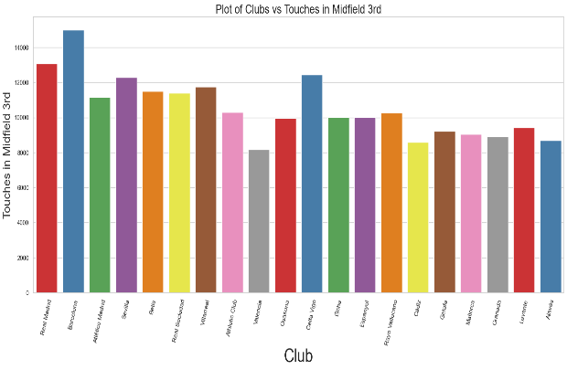
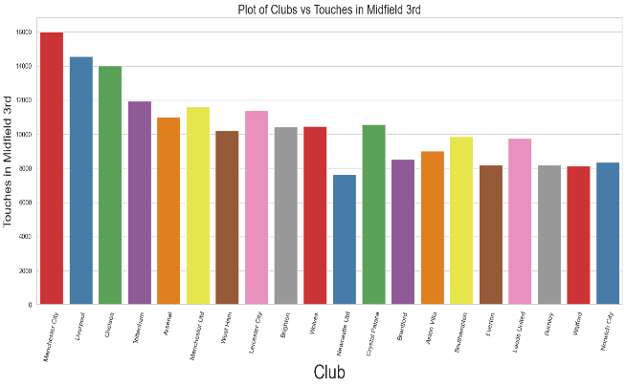
Area wise ball touches of each club?
Touches made in the midfield 3rd showed a gradual decrease down the table for both the leagues with EPL showing a steeper decline.
LALIGA
EPL

Slide 10
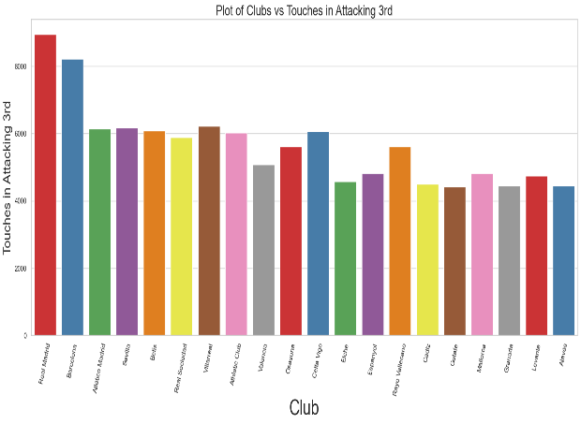
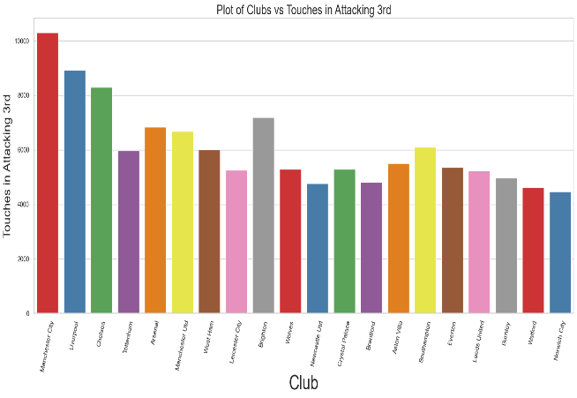
Area wise ball touches of each club?
Touches in the Attacking 3rd showed a steep decline for EPL for the first few teams and then a steady decline further down the table, for La Liga the first two teams had an unusually higher number of touches compared to the other teams, the value decreased gradually after the 3rd team went down the table.
LALIGA
EPL

Slide 11
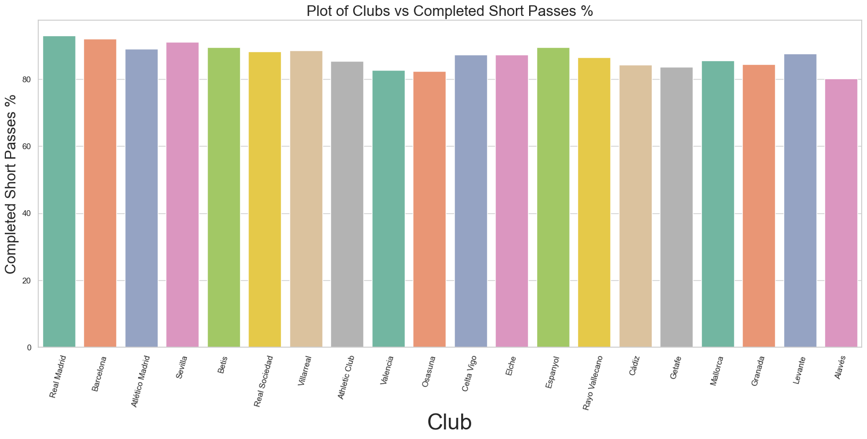
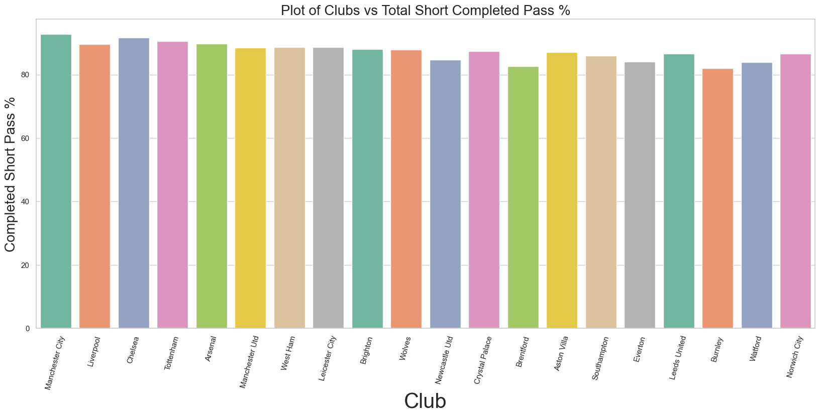
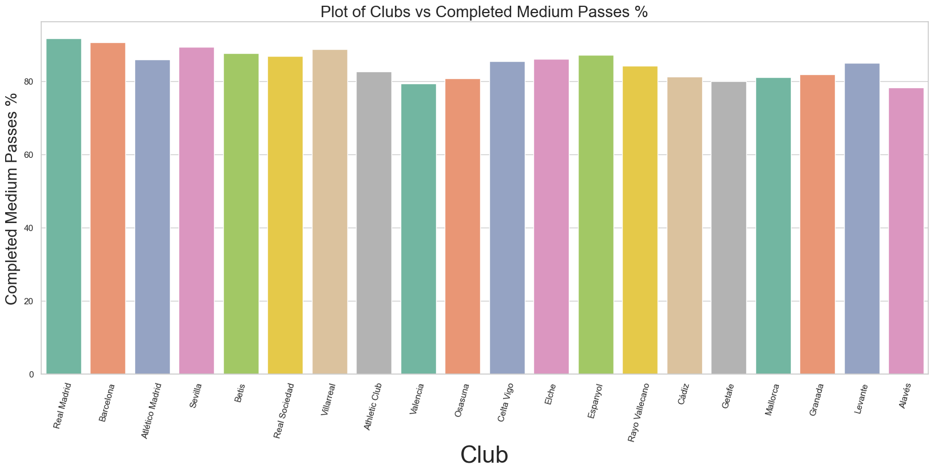
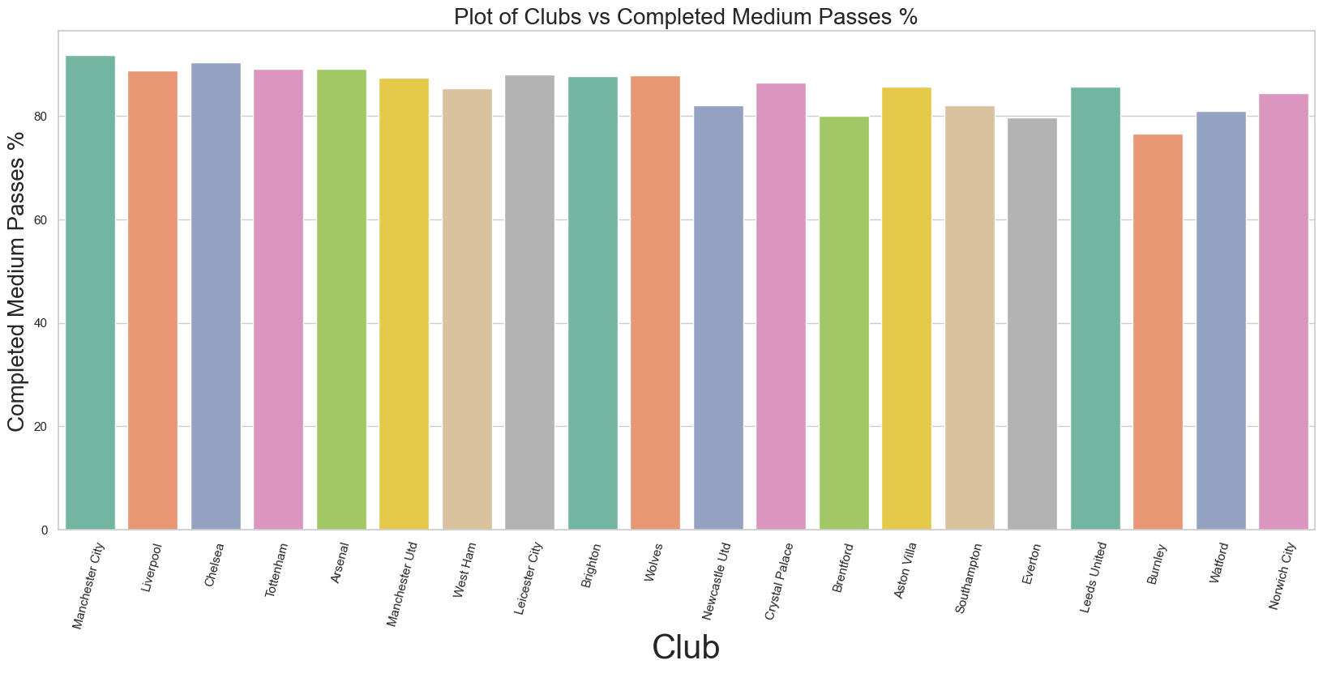
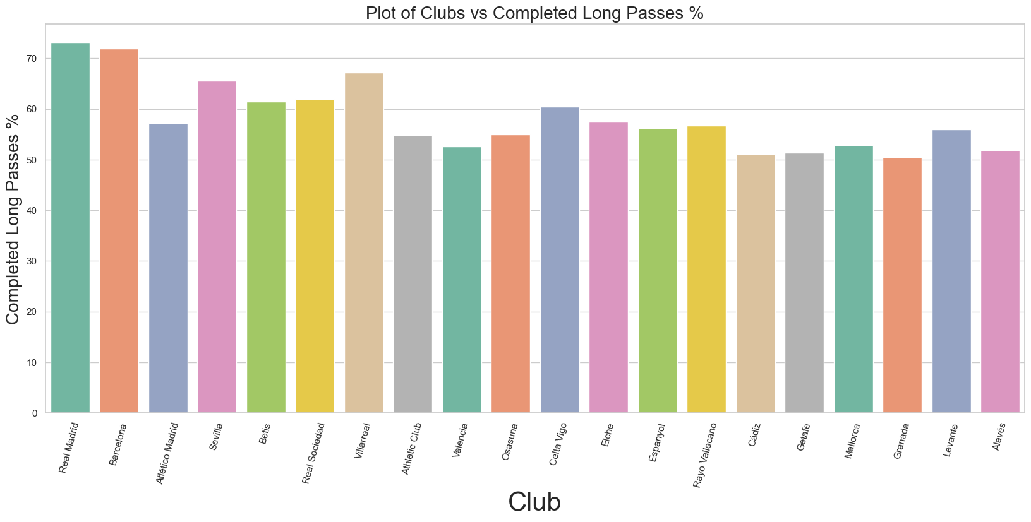
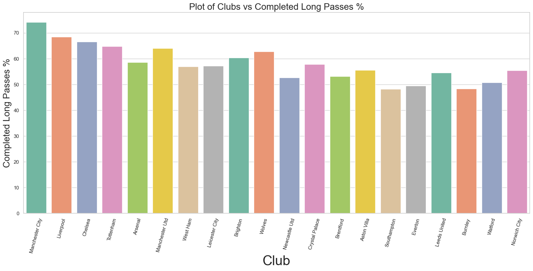
Passes completed of each type by each club?
LALIGA
EPL
Analysis on the type of passes made successfully.
We categorized the passes made into three types: short, medium and long; based on the distance of the pass being played.
Short passes showed a very gradual decrease for both the leagues with the values ranging from 86% to 83%.
Medium passes showed a gradual decrease for both the leagues with the values ranging from 85% to 80%.
Long passes showed a steady decline, steeper than compared to medium and short passes with values ranging from 74% to 50% down the table.
S
H
O
R
T
M
E
D
I
U
M
L
O
N
G

Slide 12
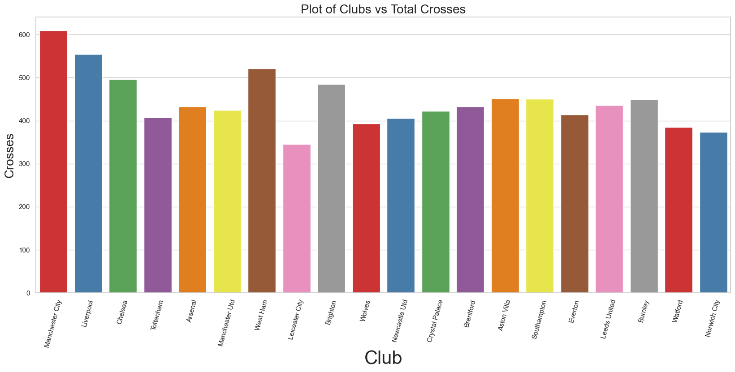
Crosses completed by each club?
Crosses are nothing but playing the ball along the width of the field, primarily in the final 3rd or the Box.
Crosses are a straight indicator of how well the wing attack of a team is or how promising it’s winger/full-back is.
Here we can transparently see that Manchester City has been the club with most crosses in EPL for the season.
It conveys that it’s winger/full-back has been pro-active on the pitch.

Slide 13
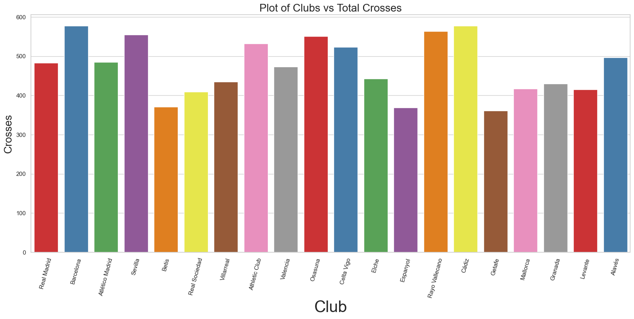
Crosses completed by each club?
Crosses are nothing but playing the ball along the width of the field, primarily in the final 3rd or the Box.
Crosses are a straight indicator of how well the wing attack of a team is or how promising it’s winger/full-back is.
Here we can transparently see that Cadiz has been the club with most crosses in EPL for the season.
It conveys that it’s winger/full-back has been pro-active on the pitch, despite not having most crosses Real Madrid managed to win the season. Indicating that crosses don’t guarantee success, it’s conversion is key. Finisher’s role is equally important.

Slide 14

Which position players scored max goals per club ?
Analysis of the goals scored as per general playing position of the players. The first sunburst chart is of La Liga teams and second is of EPL, showing the ratio of goals scored by the respective position of the player.
This gives us an insight towards individual teams and how much they depend on the forwards to score goals.
The trend suggests that majority of the football clubs are dependent on their forwards for the goal scoring process of which Liverpool is the most relied club.
On the contrary, Chelsea Football Club and Wolverhampton were either least relied or their Forwards were suppressed by players at some other position, majorly Defenders.

Slide 15

Which position players scored max goals per club ?
Analysis of the goals scored as per general playing position of the players. The first sunburst chart is of La Liga teams and second is of EPL, showing the ratio of goals scored by the respective position of the player.
This gives us an insight towards individual teams and how much they depend on the forwards to score goals.
The trend suggests that majority of the football clubs are dependent on their forwards for the goal scoring process of which Real Madrid is the most relied club.
On the contrary, unlike EPL there we almost no clubs that were either least relied or their Forwards were suppressed by players at some other position.

Slide 16
Conclusion
For La Liga, the top 9 teams on average crossed the 32% mark, and the rest of the teams had a lower average shot on target percentage of 28%. For EPL there were no such benchmarks found and the shot on target percentage did not show any obvious relation with the points gathered by the teams.
This result tends to show a slight dominance of the higher order teams in La Liga over the lower order teams.
Such dominance is not as strongly seen in the EPL as the shot on target percentage is rather evenly distributed.
The top teams of La Liga and EPL both had possession over 60% with a gradual decrease as we go down the table. The decrease was smoother in EPL as compared to La Liga.
This result is suggesting that a team is more likely to succeed if they have a higher value of possession in their games.

Slide 17
Conclusion
Analysis on the type of passes successfully made by each team shows that the value of successful long passes has a greater effect on the success of the team than compared to medium and short passes. It was seen that the top teams had a significantly higher value of successful long passes than the lower order teams. The same was not as strongly seen for medium and short passes, further signifying the,
importance of perfecting long passes for a team. This was observed in both the leagues.
Analysis of touches around the pitch suggested a clear dominance of the top two teams in La Liga over the other teams as they were far more successful in reaching the attacking 3rd, there was a steady decline in the opposition penalty area and midfield 3rd as well. EPL also showed a steep decline for the attacking 3rd but it was not as abrupt as seen in La Liga. The defensive area touches showed a very gradual increase along the table in EPL whereas for La Liga there, no such trend was observed.
Suggesting a more attacking playing style rather than holding back.

Slide 18
FUTURE SCOPE
This study only considered the current form of the teams from the two European leagues and did not take into account the history of the teams and their form over the years.
Further in depth analysis of other performance parameters like total distance covered, intention of pass(attacking, drop back. Etc.) and the work rate of the players would reveal greater insights.
This study forms the basis for a deeper research into individual performance parameters.

Slide 19
References
M. Andrews, and P. Harrington, “Off Pitch: Football’s Financial Integrity Weaknesses, and How to Strengthen Them”, Faculty Research Working Paper Series, Harvard Kennedy School, 2016, Paper No. 311, [Online] Available: https://research.hks.harvard.edu/publications/workingpapers/Index.aspx
https://fbref.com/en/comps/9/2021-2022/2021-2022-Premier-League-Stats
Sarmento, H., Figueiredo, A., Lago-Peñas, C., Milanovic, Z., Barbosa, A., Tadeu, P., et al. (2018c). Influence of tactical and situational variables on offensive sequences during elite football matches. J. Strength Cond. Res. 32, 2331–2339. doi: 10.1519/JSC.0000000000002147
Souza, D. B., Campo, R. L., Blanco-Pita, H., Resta, R., and Coso, J. D. (2019). A new paradigm to understand success in professional football: analysis of match statistics in LaLiga for 8 complete seasons. Int. J. Perform. Anal. Sport 19, 543–555. doi: 10.1080/24748668.2019.1632580
Rampinini, E., Impellizzeri, F. M., Castagna, C., Coutts, A. J., and Wisløff, U. (2009). Technical performance during soccer matches of the Italian Serie A league: effect of fatigue and competitive level. J. Sci. Med. Sport 12, 227–233. doi: 10.1016/j.jsams.2007.10.002
Lepschy, H., Wäsche, H., and Woll, A. (2018). How to be successful in football: a systematic review abstract. Open Sports Sci. J. 11, 3–23. doi: 10.2174/ 1875399X01811010003
Grant, A. G., Williams, A. M., and Reilly, T. (1999b). An analysis of the successful and unsuccessful teams in the 1998 World Cup. J. Sports Sci. 17:827.
Hook, C., and Hughes, M. (2001). Patterns of Play Leading to Shots in ‘euro 2000’. Cardiff: UWIC.

Slide 20
References
Carling, C., Williams, A. M., and Reilly, T. (2005). Handbook of Soccer Match Analysis: A Systematic Approach to Improving Performance. Abingdon: Routledge.
Bloomfield, J. R., Polman, R. C. J., and O’Donoghue, P. G. (2005). Effects of score-line on team strategies in FA Premier League Soccer. J. Sports Sci. 23, 192–193.
Jones, P. D., James, N., and Mellalieu, S. (2004). Possession as a performance indicator in soccer. Int. J. Perform. Anal. Sport 4, 98–102. doi: 10.1080/24748668.2004.11868295
Casal, C. A., Losada, J. L., and Ardá, T. (2015). Análisis de los factores de rendimiento de las transiciones ofensivas en el fútbol de alto nivel. Rev. Psicol. Deporte 24, 103–110.
Casal, C. A., Maneiro, R., Ardá, T., Marí, F. J., and Losada, J. L. (2017). Possession zone as a performance indicator in football. the game of the best teams. Front. Psychol. 8:1176. doi: 10.3389/fpsyg.2017.01176
Souza, Diego & López del Campo, Roberto & Pita, Hugo & Resta, Ricardo & Del Coso, Juan. (2019). An Extensive Comparative Analysis of Successful and Unsuccessful Football Teams in LaLiga. Frontiers in Psychology. 10. 2566. 10.3389/fpsyg.2019.02566.
Dellal, A., Chamari, K., Wong, D. P., Ahmaidi, S., Keller, D., Barros, R., … Carling, C. (2011). Comparison of physical and technical performance in European soccer match-play: FA Premier League and La Liga. European Journal of Sport Science, 11(1), 51–59. https://doi.org/10.1080/17461391.2010.481334
Anzer, Gabriel & Bauer, Pascal. (2021). A Goal Scoring Probability Model for Shots Based on Synchronized Positional and Event Data in Football (Soccer). Frontiers in Sports and Active Living. 3. 10.3389/fspor.2021.624475.

Slide 21
Thank You!

